Slide 1

State management clarified An overview of technologies

Slide 2



Rodney Wormsbecher
https://www.linkedin.com/in/rocodemy

Slide 3



Peter Eijgermans
@EijgermansPeter

Slide 4
Agenda
Understanding what is state.
State management.
Comparison of state management and examples.
Redux in theory.
Redux in practice.
Zustand
NgRx SignalStore in Action
Summary

Slide 5
Understanding what is state

Slide 6
Understanding State
State is the current “data in memory” of the application.
It contains all the data that enables the application to function properly and render its view.

Slide 7
Understanding State
Every component-based frontend framework contains a basic way to pass state between components. Let’s look at an example.

Slide 8

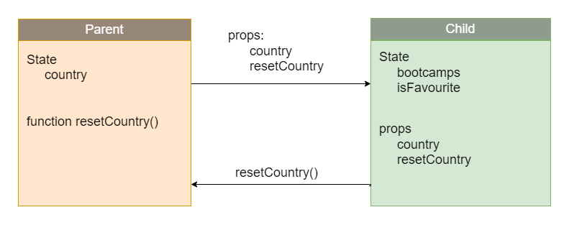
Understanding State
React:
Country state and function gets send to child
Country state and functions gets send down to child the second time
Function is executed and updates country state
Function gets called in child
Function returns to parent “execution context”

Slide 9

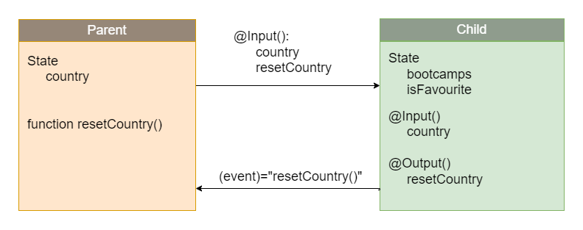
Understanding State
Angular:
Country state gets passed to child via @Input
Function is executed and updates country state
Event emitted to parent via @Output

Slide 10
Understanding State
@Input and props are both “read-only” data, so how does React or Angular handle updates?

Slide 11
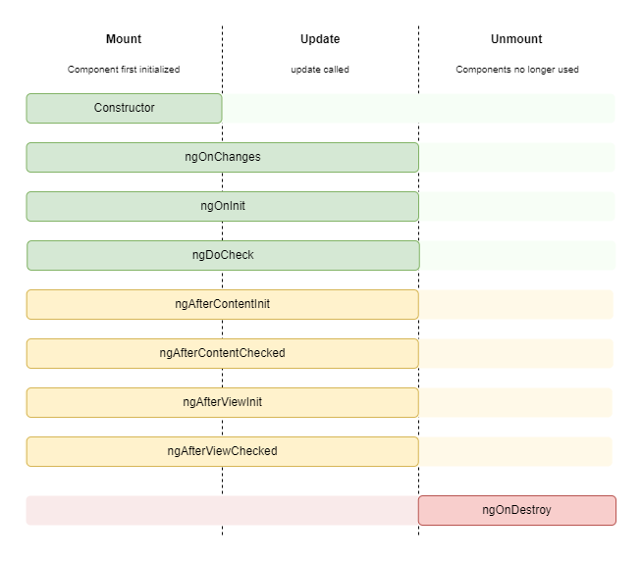
Understanding State lifecycle Angular

Slide 12
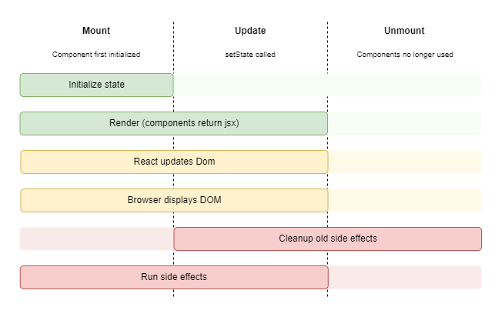
Understanding State lifecycle React

Slide 13
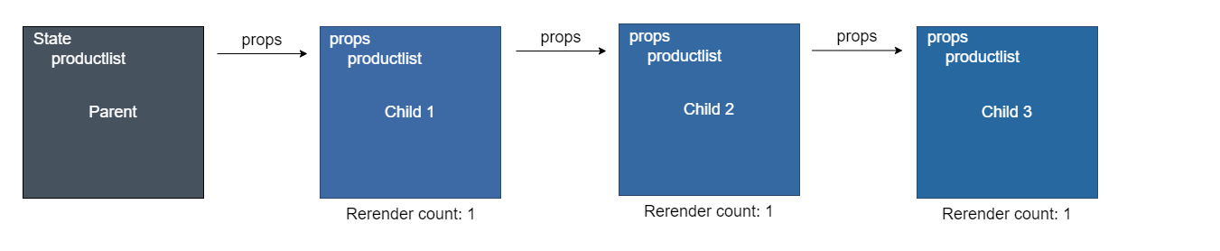
Understanding State

Slide 14
Understanding State
Components render every time some prop or state has changed, which means this creates a serious problem when passing data into deep levels.

Slide 15
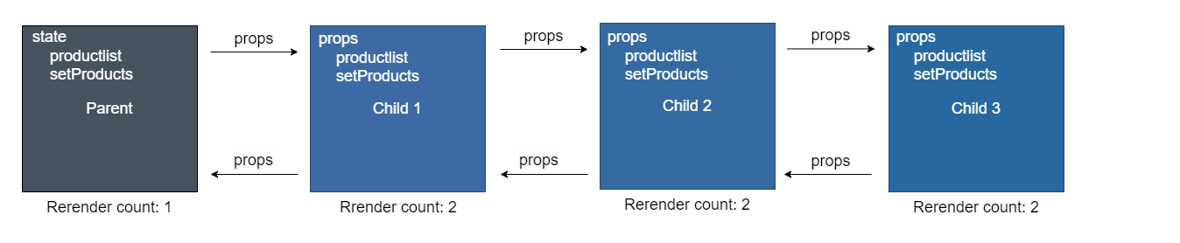
Understanding State

Slide 16
Understanding State
Though this way of state management works. It has significant problems.
We have no idea where state is created and where it leads to.
Because props and functions have to be passed through many components, they will all re-render each cycle.
Debugging and reactoring can get very complex when the app grows bigger.

Slide 17

State management

Slide 18
Understanding State Management
In frontend development, state management tools are special packages / tools designed to handle and keep track of a web application's data.

Slide 19
Understanding State
This "state" means the important information and data, for example: what users enter, the app's settings, and whether a user is logged in, that the application needs to remember to work properly.

Slide 20
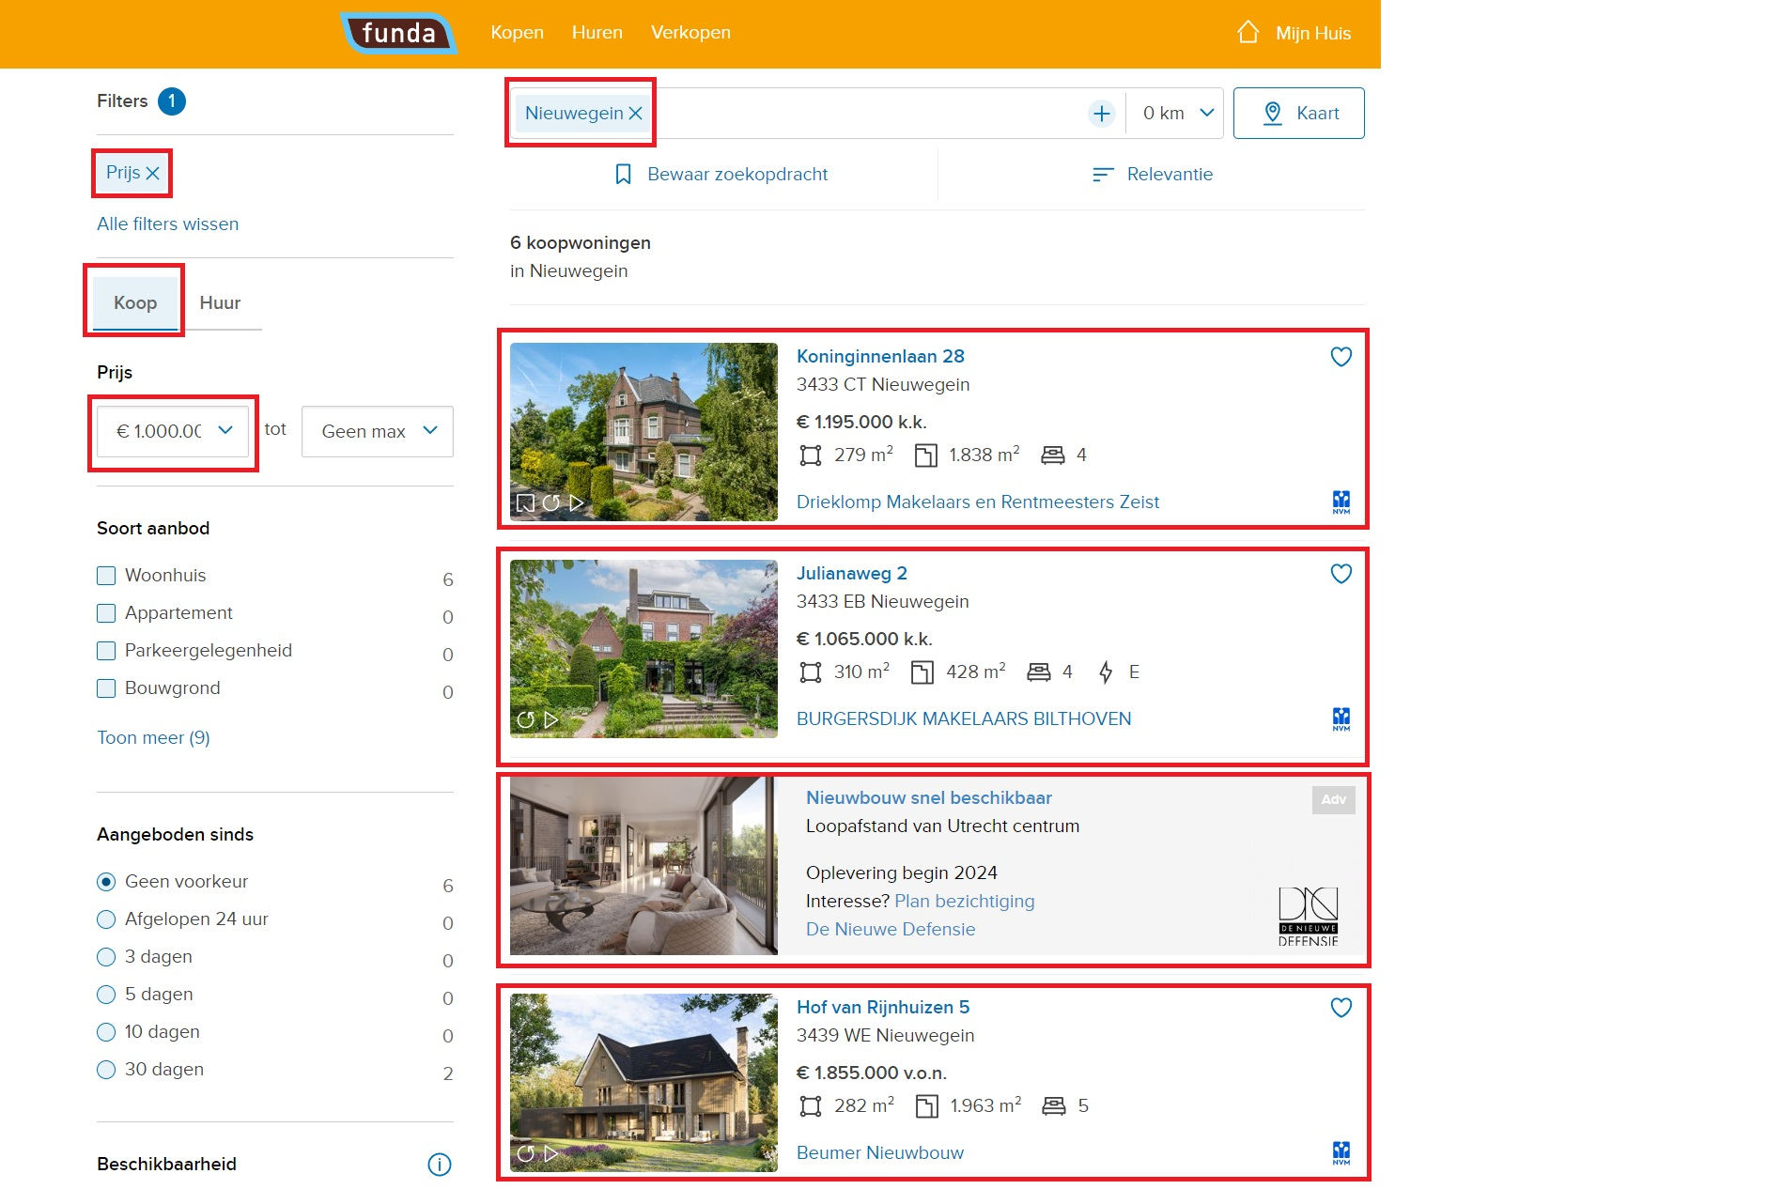

Slide 21
State management solutions
Good state management solutions achieve the following:
Decouple state from application logic.
Predictable state changes (patterns).
Improved maintainability

Slide 22
State management solutions
But also have certain drawbacks:
Learning curve.
Adds complexity.
Might be overkill for your goals.

Slide 23
History of State management

Slide 24
State management solutions
Over the years numerous packages have been created to deal with state for frontend applications.

Slide 25
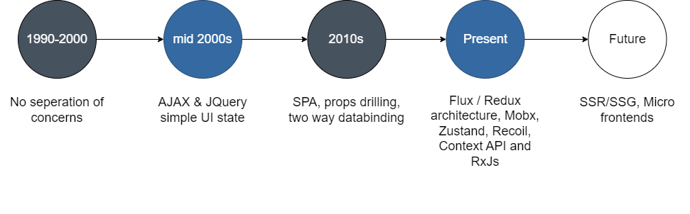
History of state management

Slide 26
History of state management 1990-2000
In this era most of the state was hardcoded in JavaScript scripts which were embedded in the page itself. Common usage:
Hide/show UI parts
Dialog boxes

Slide 27
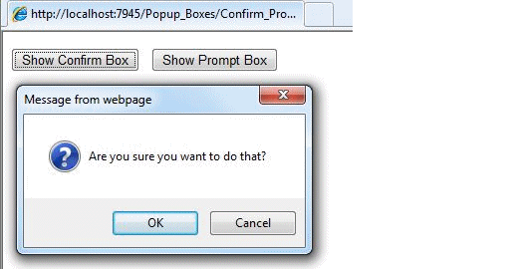
History of state management 1990-2000

Slide 28
History of state management 2000 – 2008~
AJAX and JQuery reworked the way we wrote JavaScript. It allows for better separations of concerns and enabled developers to use a lot more JavaScript.
Form complexity
Asynchronous HTTP requests
Dynamically update parts of the web page
UI state
UI enhancements like Carousels , sliders, etc.

Slide 29

History of state management 2000 – 2008~

Slide 30
History of state management 2008 – 2013~
SPAs really introduced developers to separation of concerns and enabled us to create complex applications. Frameworks like AngularJS, Backbone.js and Ember.js drove us this direction.
State in controllers/components
Two-way data-binding.

Slide 31

History of state management 2008 – 2013~

Slide 32
History of state management 2014 - Present
Flux architecture and various movements around it made it possible to have (partial) Global state management libraries. Let’s look at some of the options...

Slide 33
History of state management 2014 - Present
Partial state libraries:
Context API / React Hooks
RxJS / Signals
React-Query / SWR (server side connected)

Slide 34
History of state management 2014 - Present
Global state management libraries:
Redux (and NGRX)
Zustand
Recoil
MobX

Slide 35
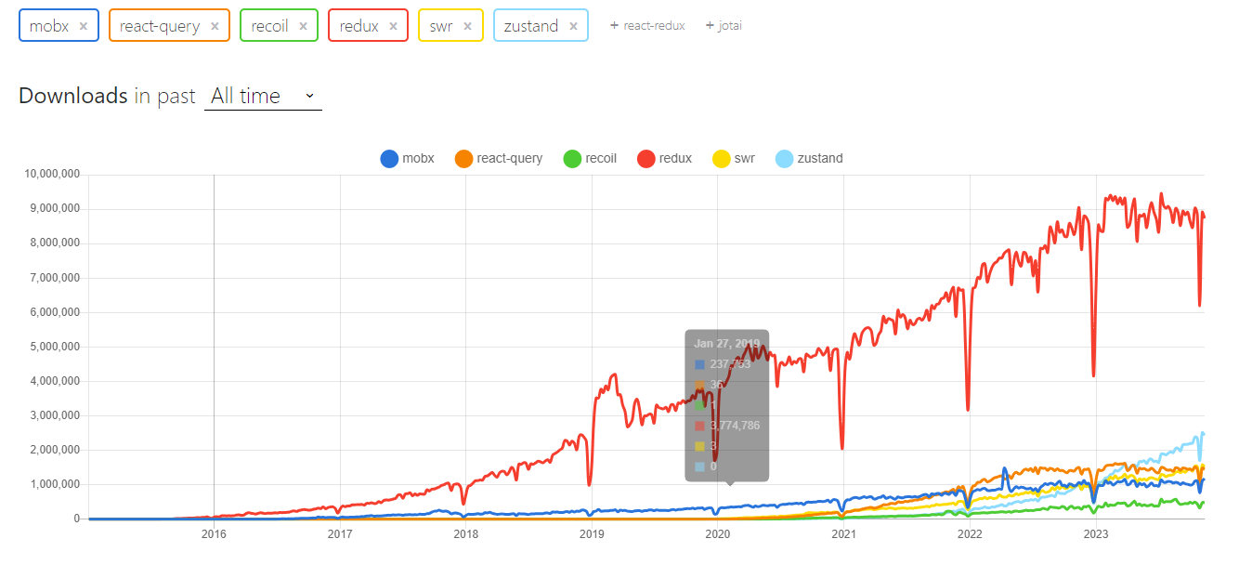
Comparison of state management libraries

Slide 36
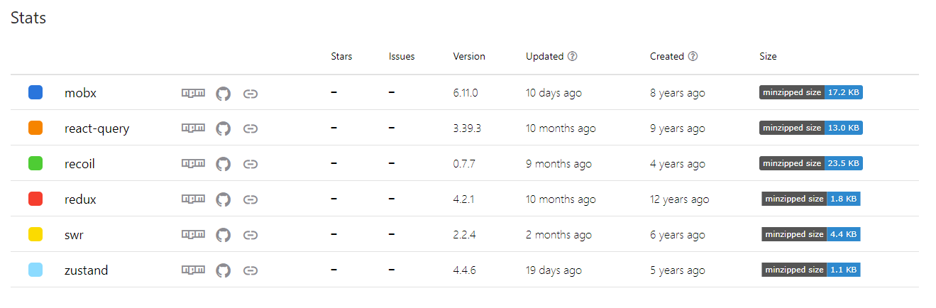
Comparison of state management libraries

Slide 37
History of state management 2014 - Present
Even though NPM trends give us a good indication for popularity, it does not mean it can give you a definite answer. It only shows popularity and whether it’s actively maintained.
PS: RxJs and React context could not be measured separately by NPM trends.

Slide 38
State management in examples

Slide 39
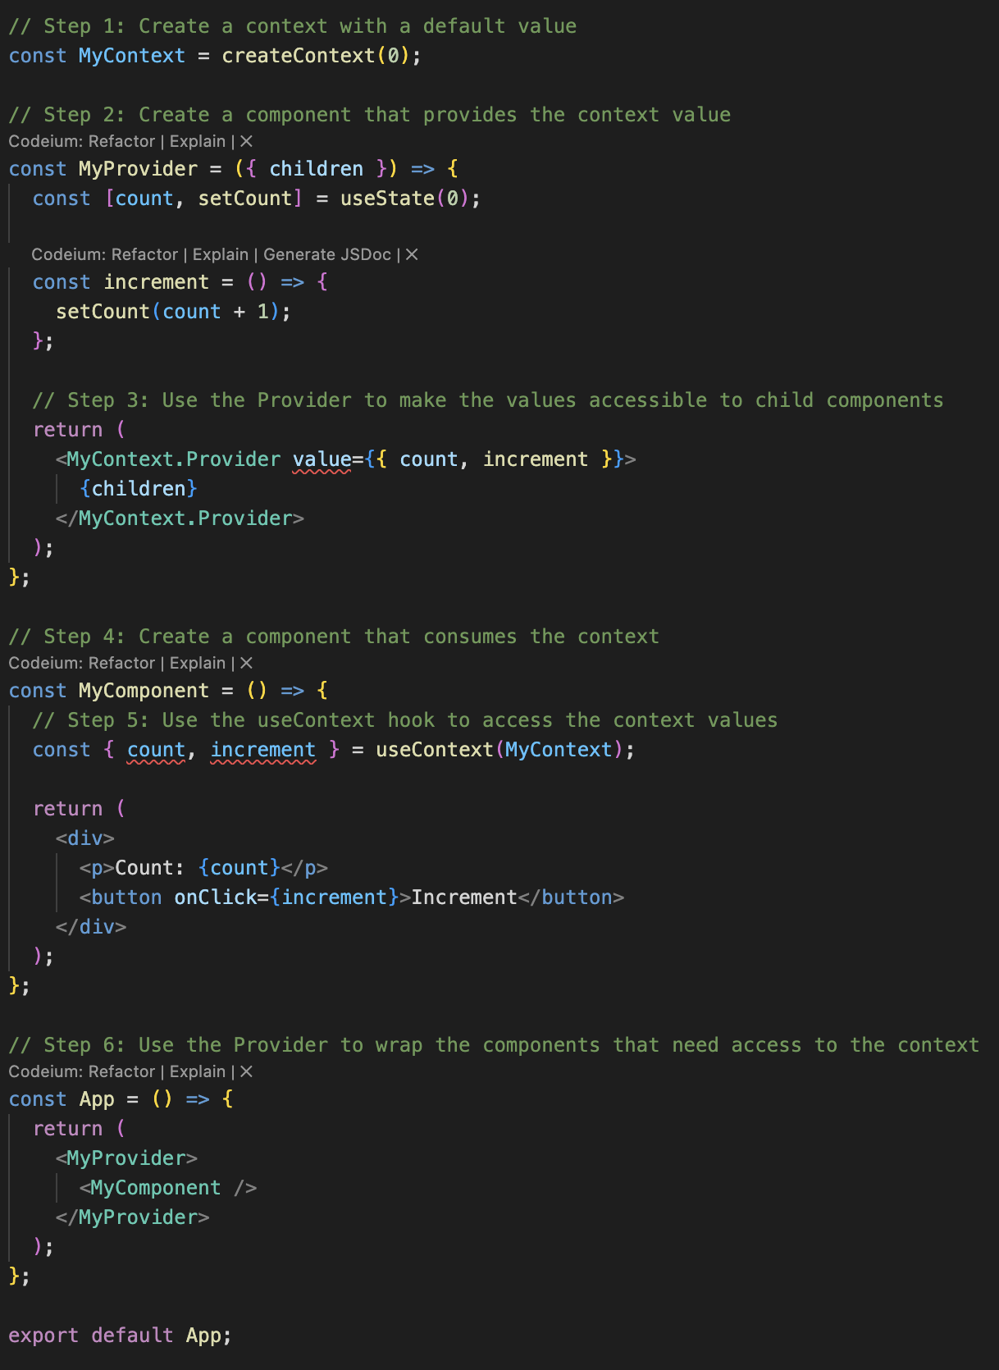
Context API

Slide 40
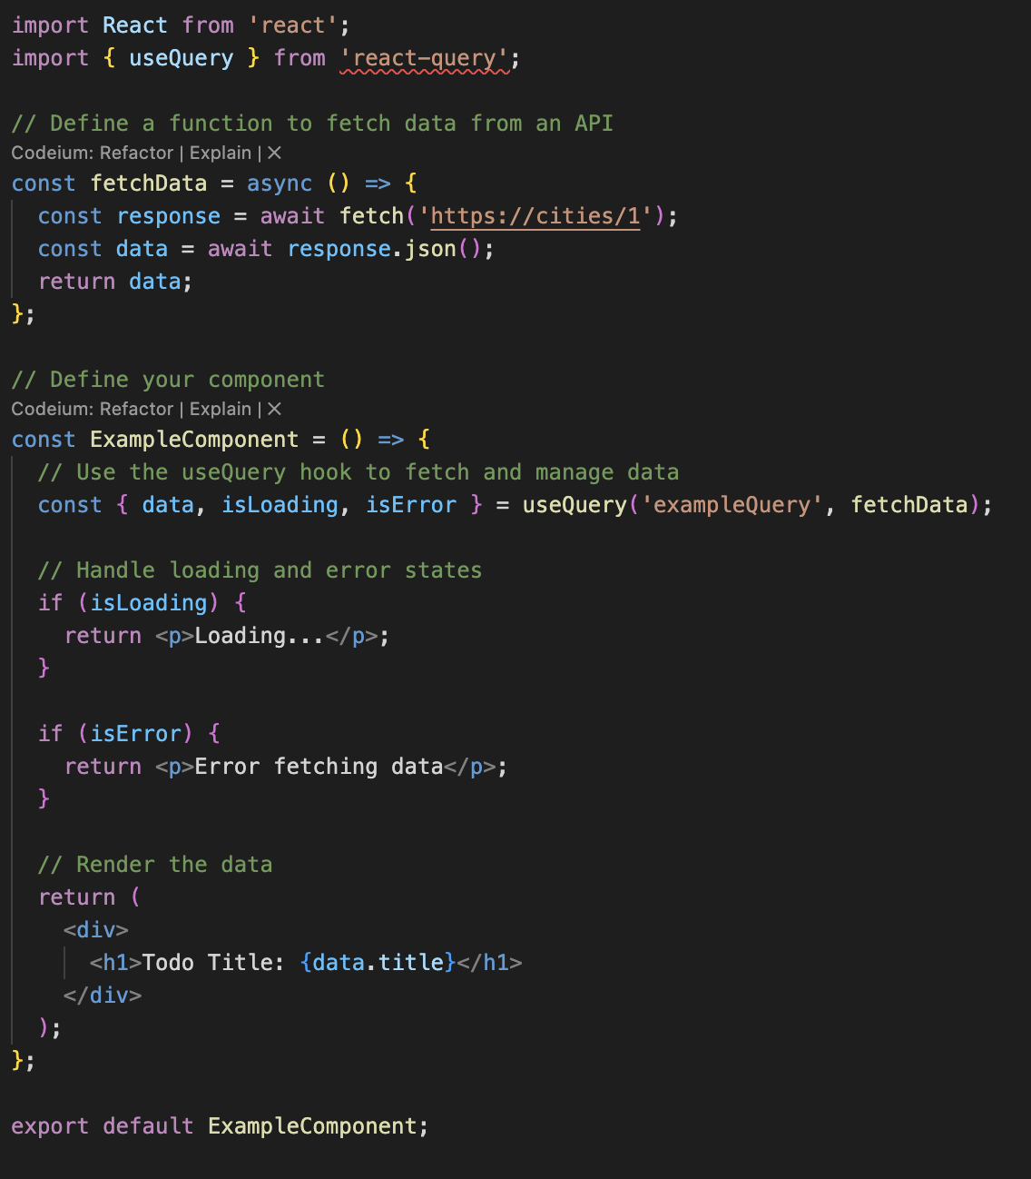
React query

Slide 41
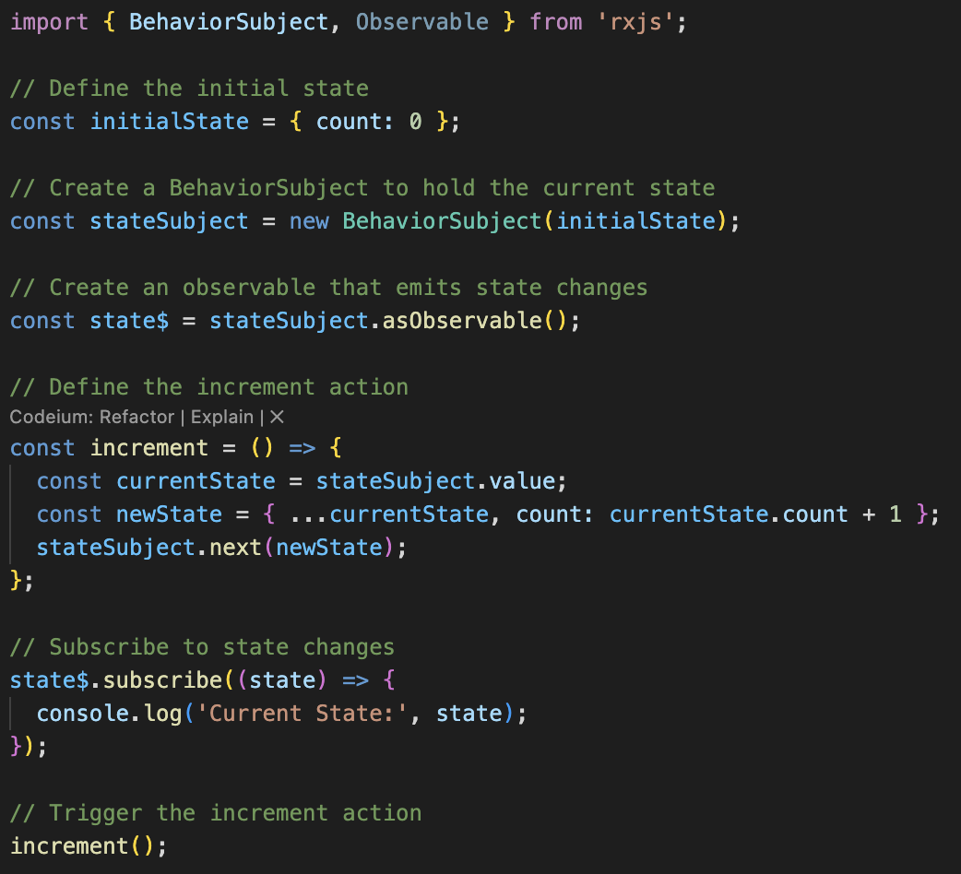
RxJS

Slide 42
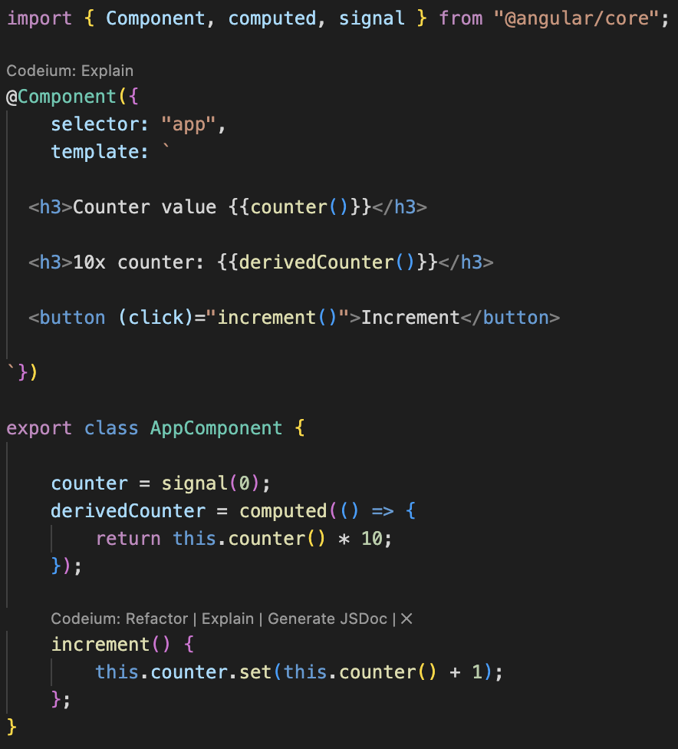
Signals

Slide 43
Redux in theory

Slide 44
Redux in theory
Redux is a technology to hold a “json database” in memory. It is contained in a “Store” and works together with actions, reducers and effects.

Slide 45
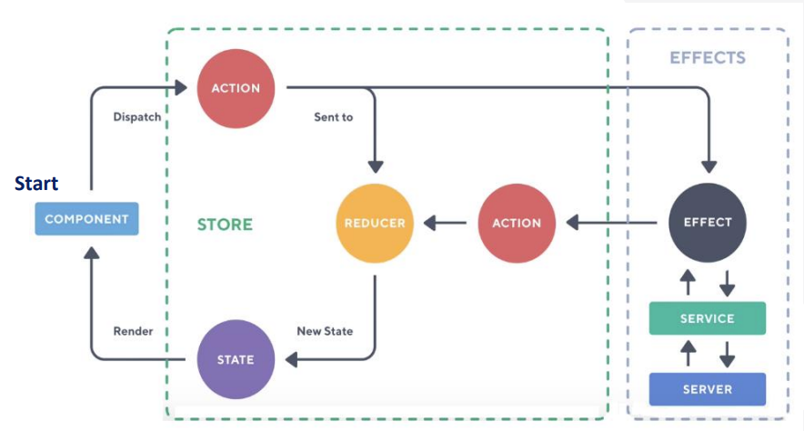
Redux in theory

Slide 46
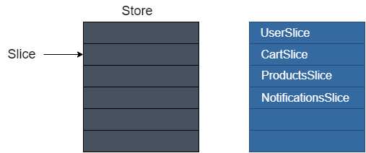
Redux in theory
A store consists out of “slices” which is similar to a top-level property of a JSON object.

Slide 47
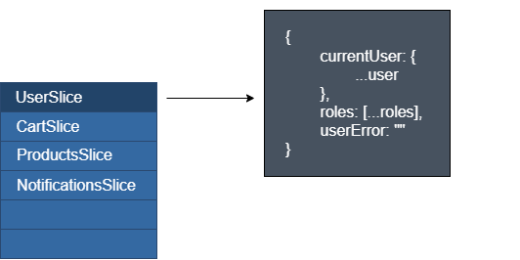
Redux in theory
A slice of data contains all relevant data to its parent and can become quite a large JSON object.

Slide 48
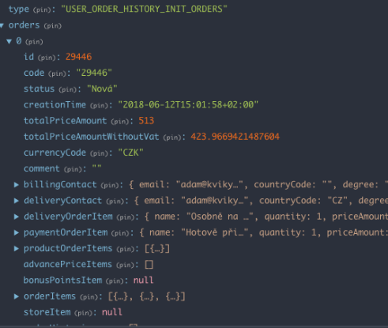
Redux in theory
A redux store used in a real-world application.

Slide 49
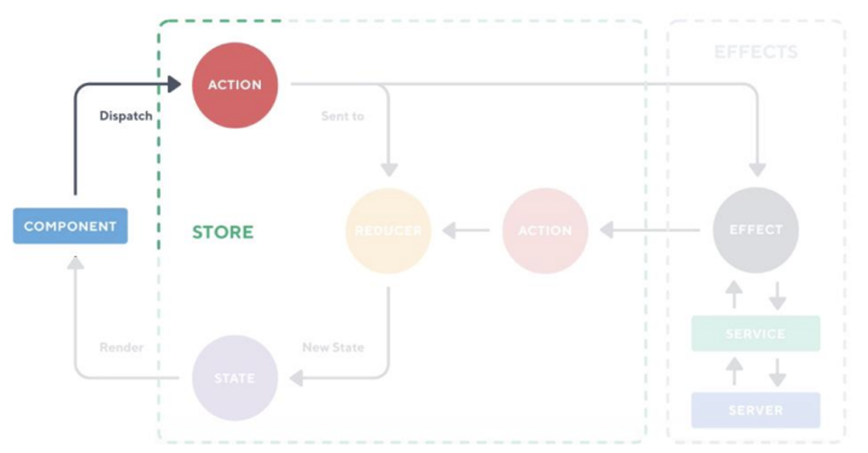
Redux in theory: Action
A user always start with DOM interaction at the component, which will then dispatch an action to Redux

Slide 50
Redux in theory: Action
An action is a blueprint of the information that will be send to the reducer. It has one compulsory property: “type” it’s used as string where reducers listen for.
It is immutable
It can be listened to by multiple reducers, but it really shouldn’t.

Slide 51
Redux in theory
We will take a look at 2 examples of the bare minimum of an action with one piece of data being sent to the reducer.

Slide 53
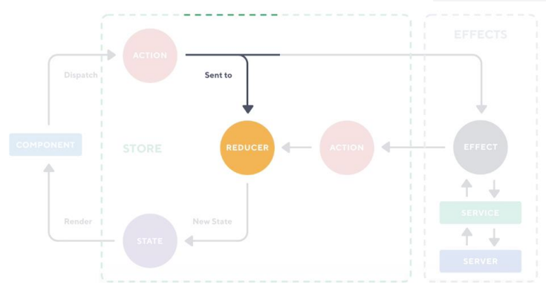
Redux in theory: Reducer
A reducer handles the business logic of your state. The action being dispatched contains the data.

Slide 54
Redux in theory: Reducer
A reducer always has these parts:
Initial state when the reducer is constructed.
A “switch” like decision tree.
Business logic which data to save per action.

Slide 55
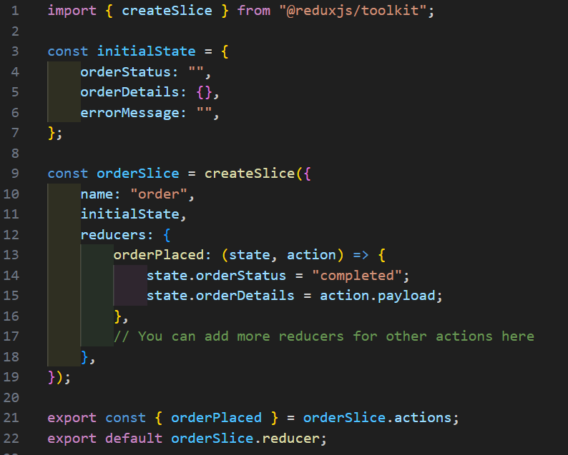

Slide 56
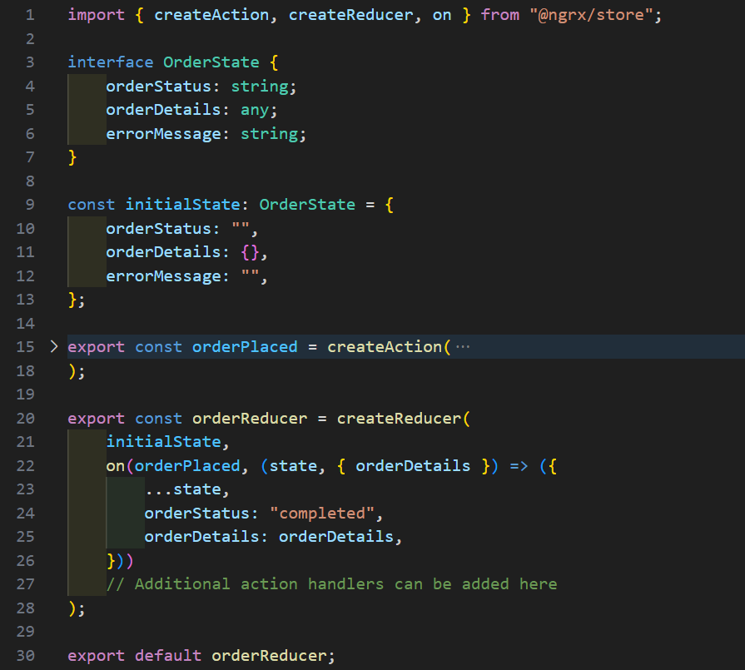

Slide 57
Redux in theory: Reducer
A reducer has a few characteristics that we have to keep in mind.
The state is immutable and needs a deep copy prior modifying it. Redux-toolkit uses 'immer' for this.
It’s considered best practice to keep logic as small as possible.

Slide 58
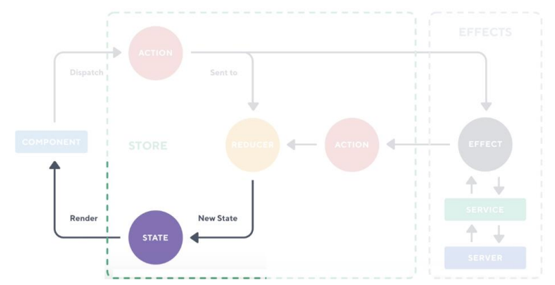
Redux in theory: State and Selectors
Redux works with subscribers, once the data is updated, the component will be notified and rerenderd. This makes it a reactive programming concept.

Slide 59
Redux in theory: Selectors and dispatchers
A component can interact with the store in 2 ways.
Selector, it gets data from the store as subscription.
Dispatch, it dispatches an action which will be handled by the reducer.

Slide 60
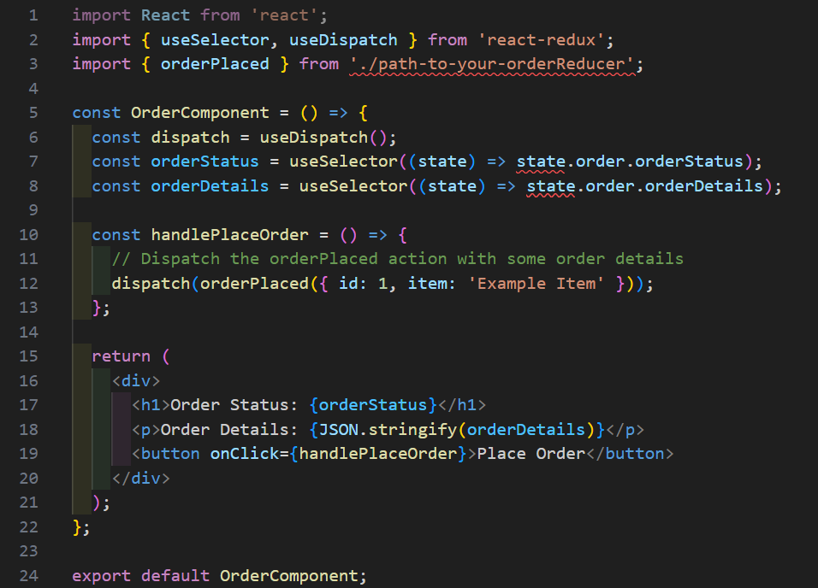

Slide 61
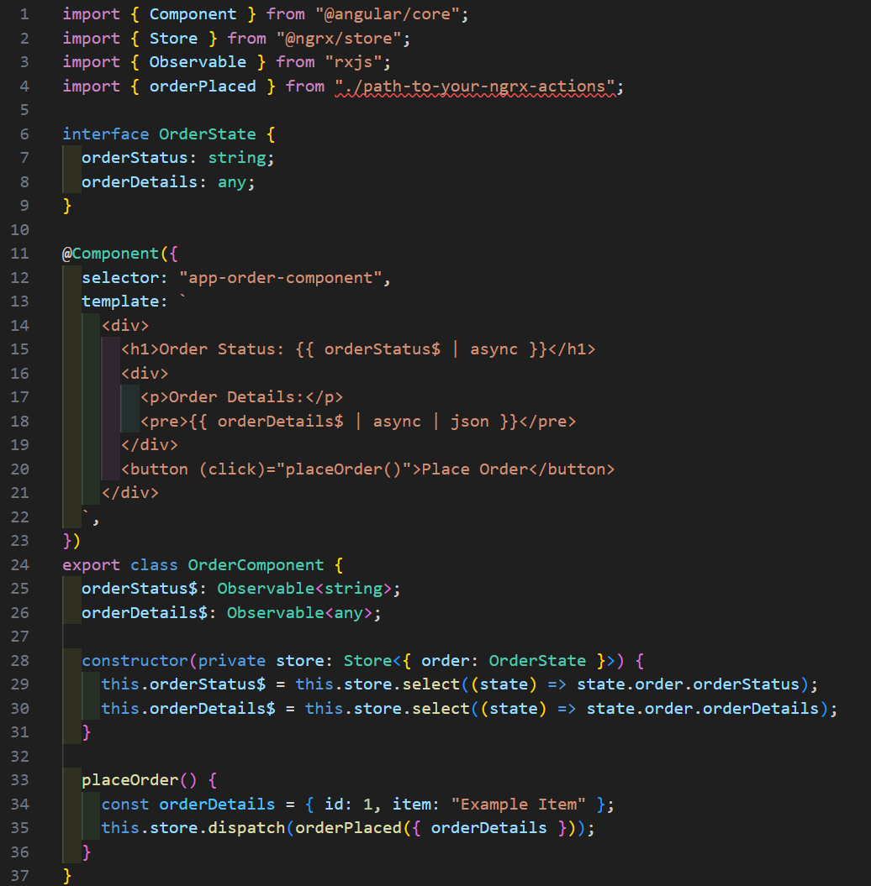

Slide 62
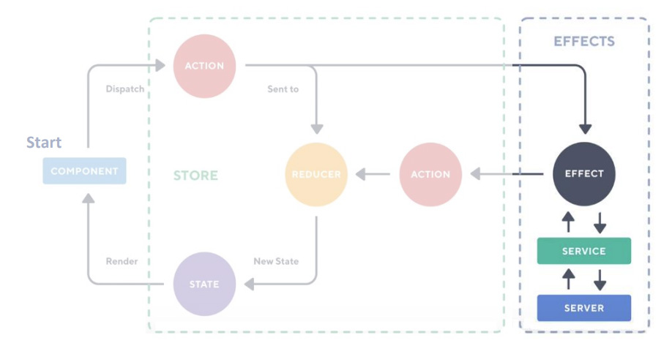
Redux in theory: Effects
Redux supports side-effects by using effects. It enables developers to fetch data when an action is called.

Slide 63
Redux in theory: Middleware / Effects
Redux accepts middleware which intercepts an action before it reaches the reducer. The middleware can then send out actions to inform the store of the new state.

Slide 64
Redux in theory: Middleware
Common side effect middlewares are:
Redux-thunk, Redux-saga, Redux-observable for React.
NgRx effect for Angular.

Slide 65
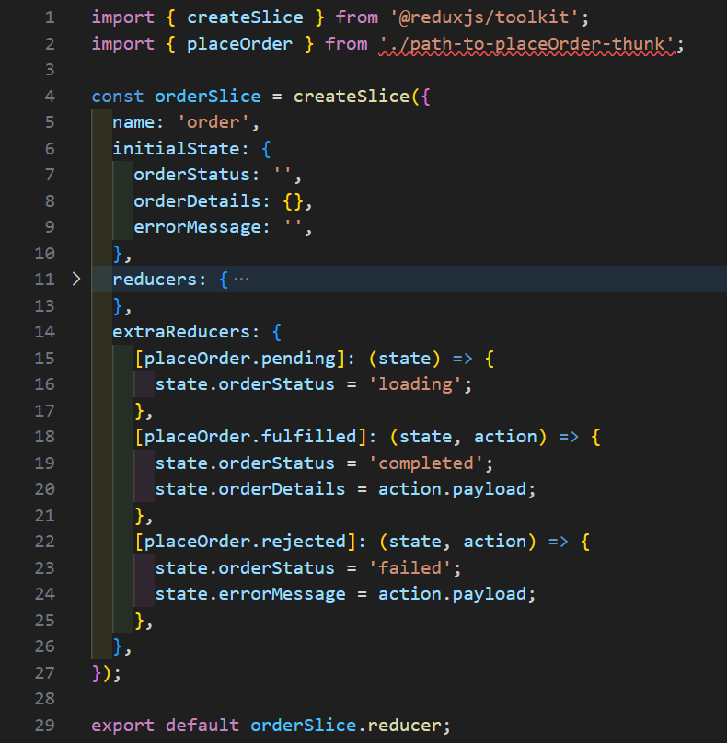
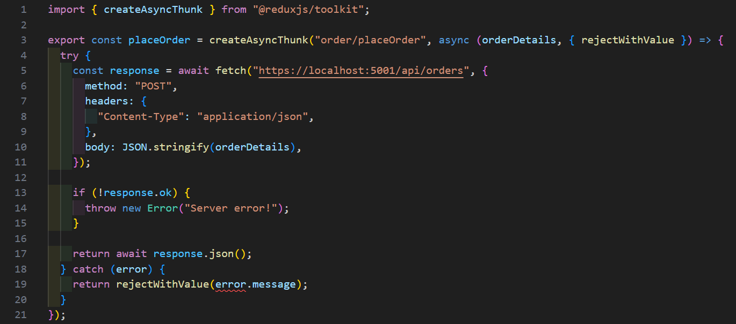

Slide 66
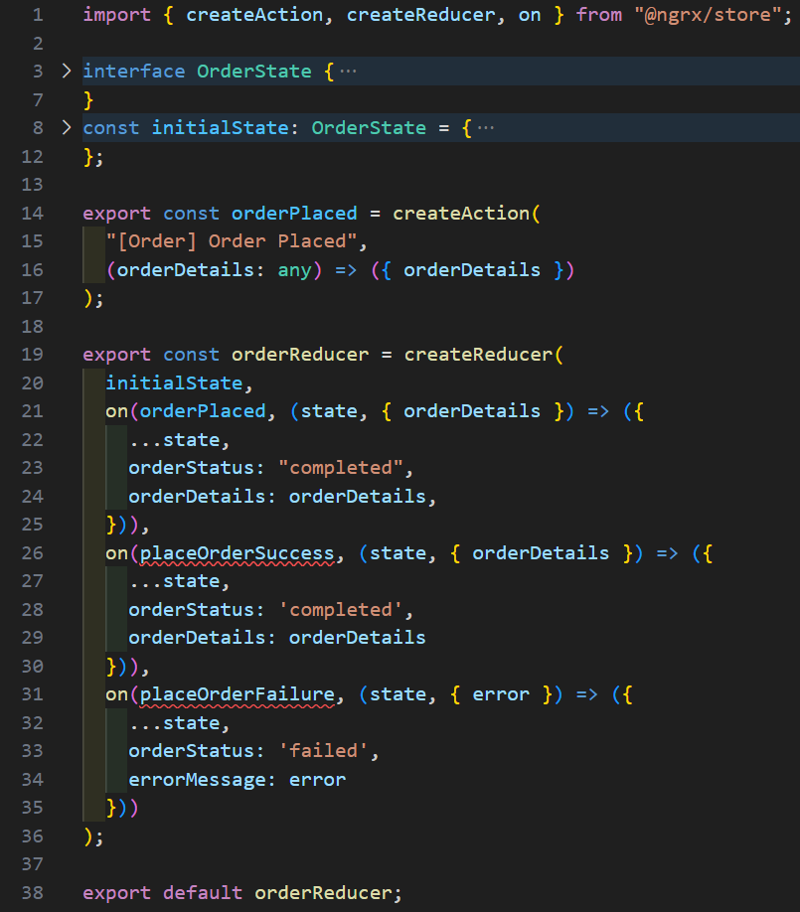
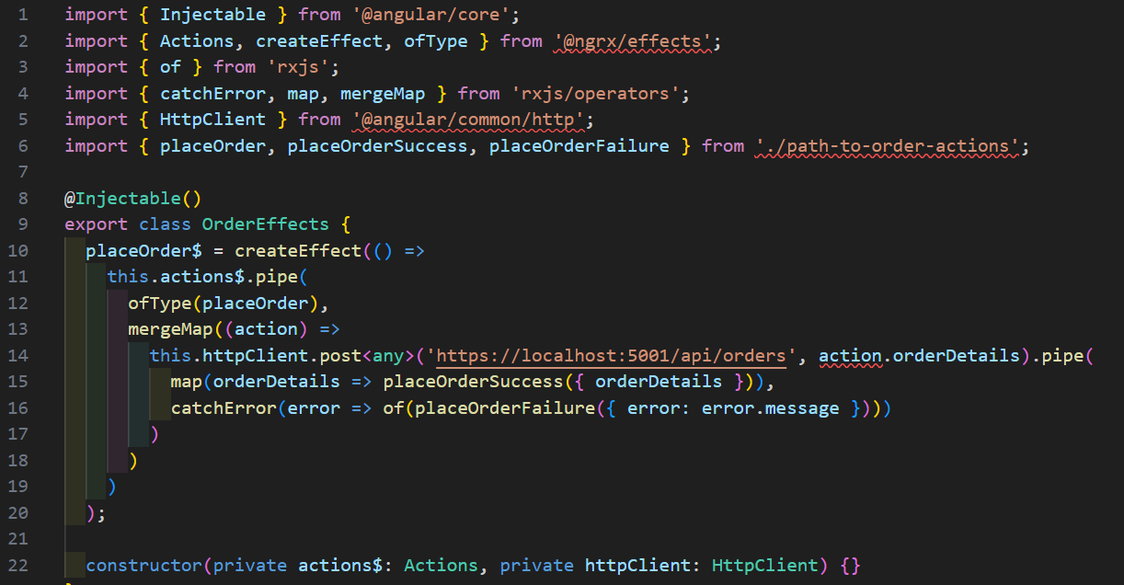
placeOrder
Place order

Slide 67
Redux in theory: Middleware
Effects are a resilient way fetching data and will then be available in the store.
An effect usually contains 3 states: loading, success, failure.
For separation of concerns, you could extract your fetching into a Service or custom hook.

Slide 68
Redux in practice

Slide 69
Zustand

Slide 70
Demo
Zustand

Slide 71
SignalStore

Slide 72
SignalStore: What and Why?
Lightweight
Reusability
Scalable
Clean code
New features: entity-package, RxJS-interop

Slide 73
SignalStore: How?
npm install @ngrx/signals

Slide 74
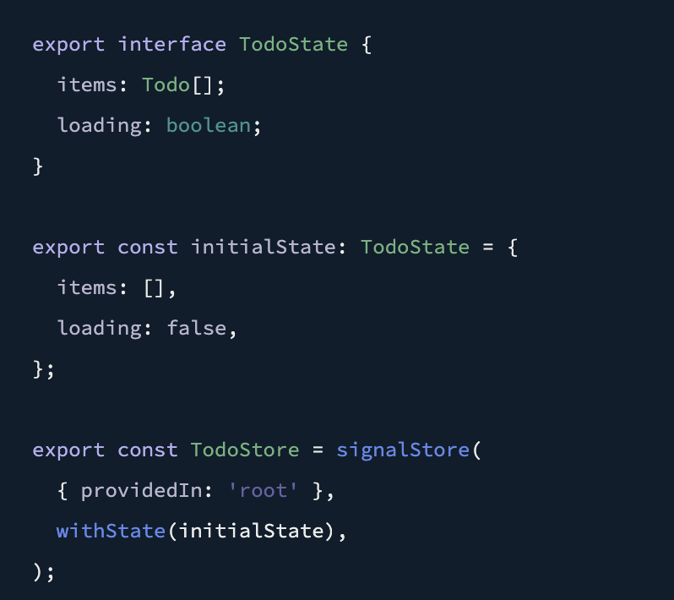
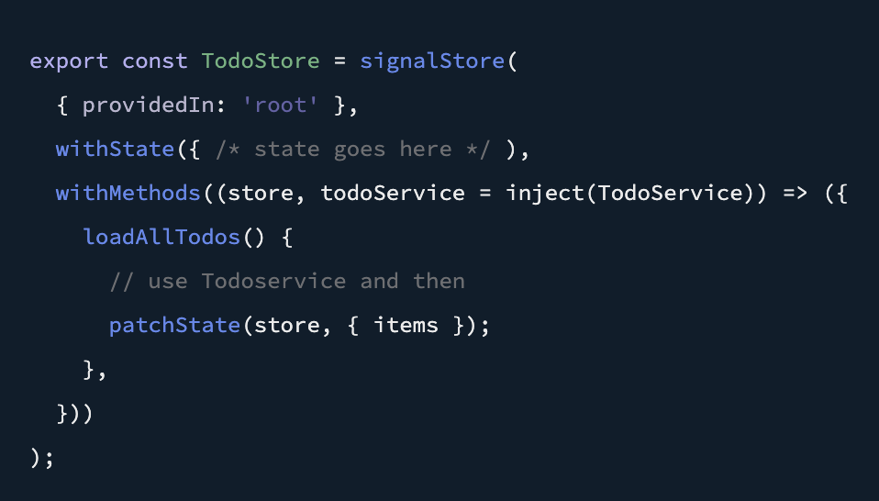
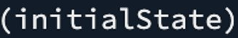
patchState
=
Reducer

Slide 75
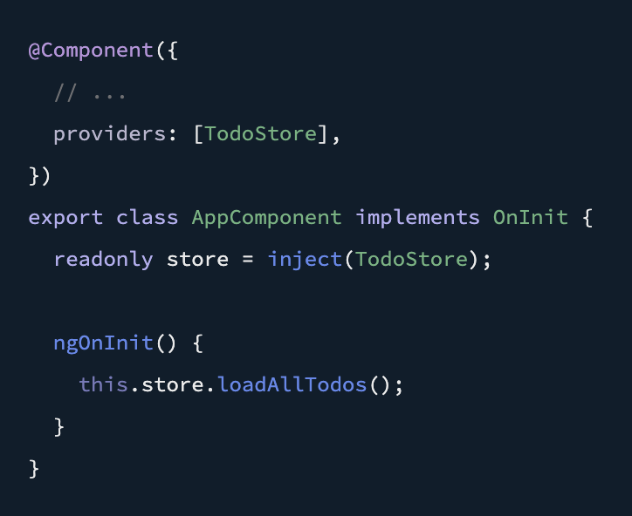
No Actions(!)
needed anymore

Slide 76
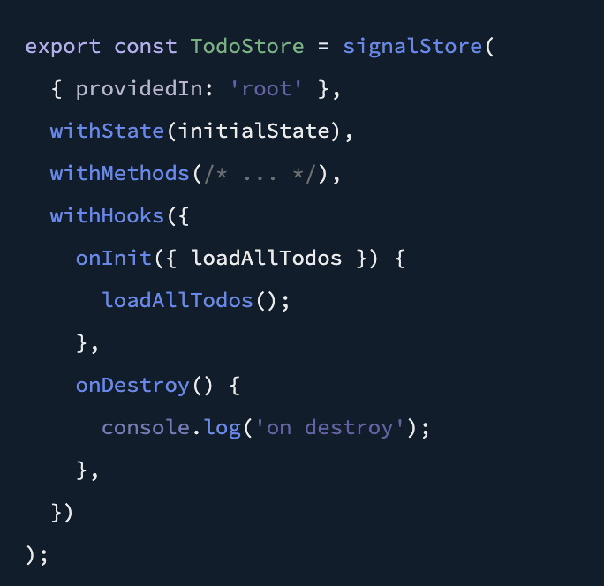

Slide 77
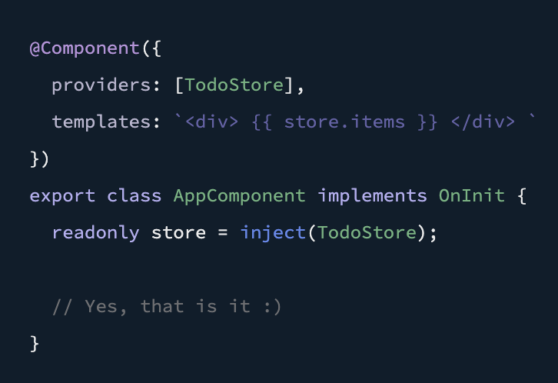

Slide 78
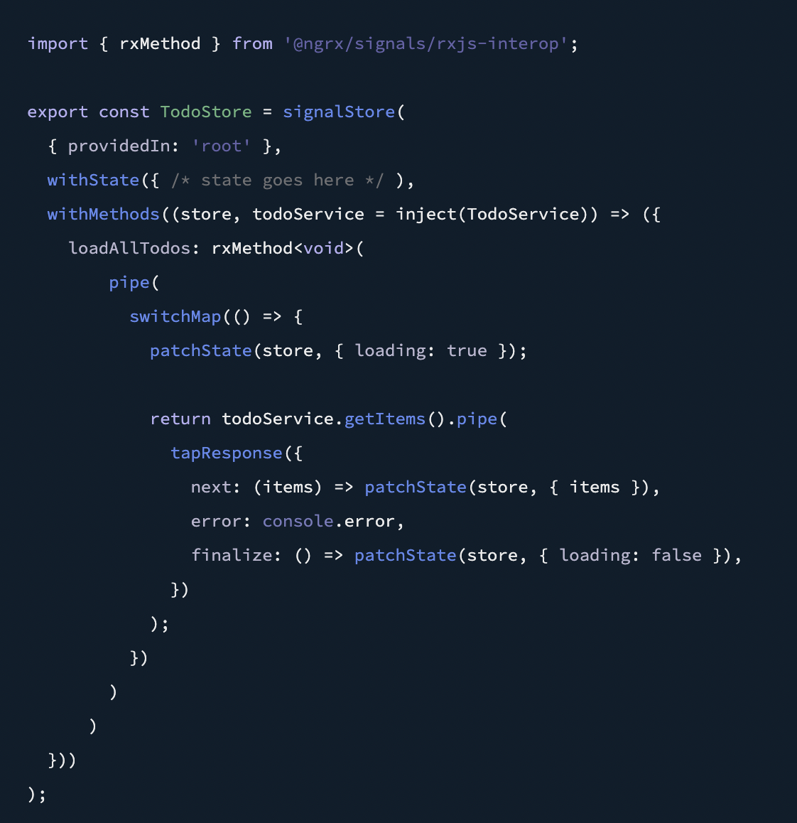
WithMethod =
Effects

Slide 79
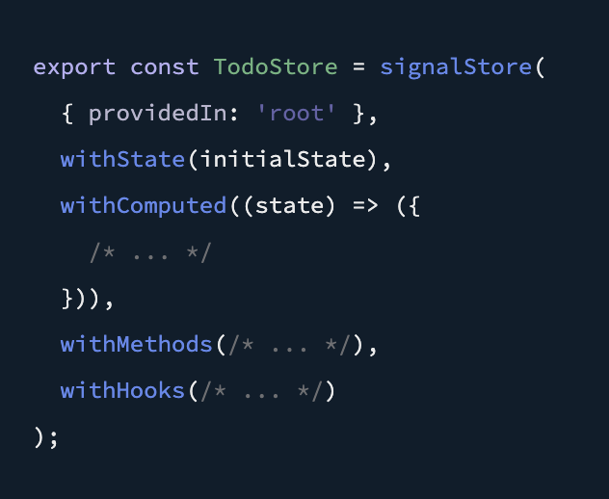
Reading the data from the store withComputed
WithComputed =
Selector

Slide 80
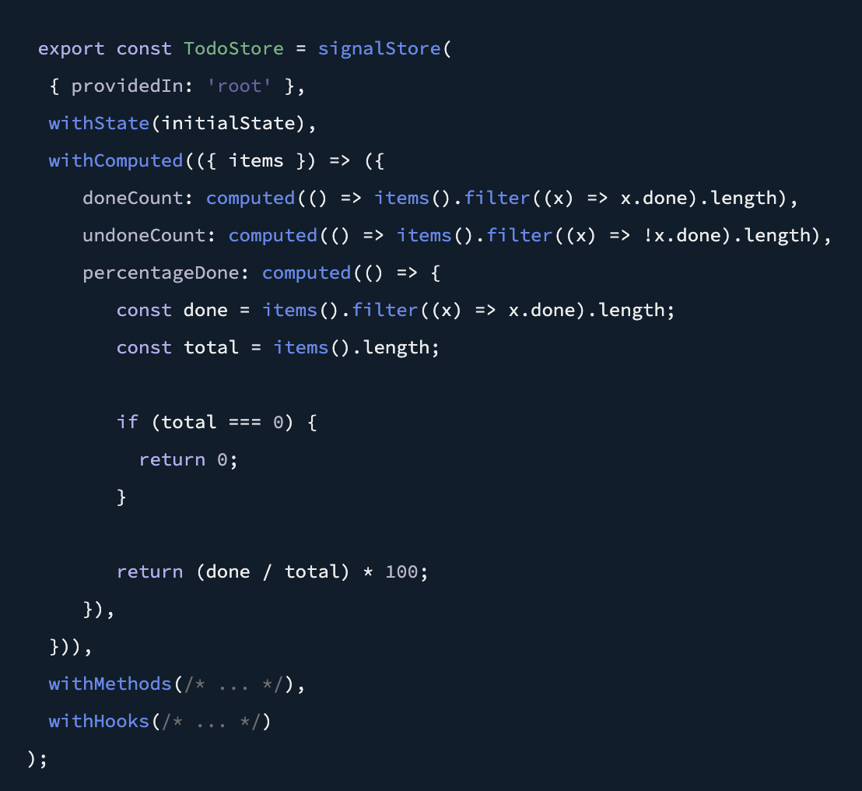
Reading the data from the store withComputed

Slide 81
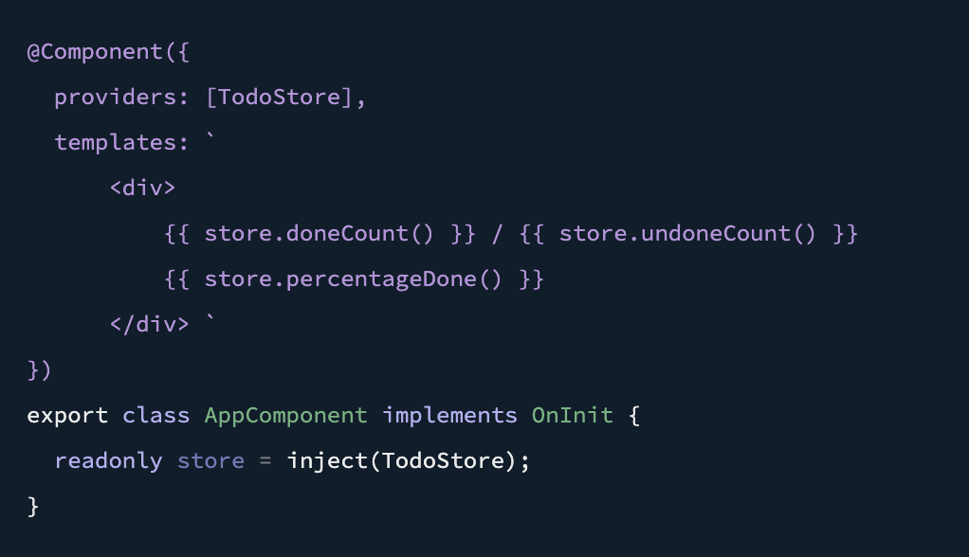
Reading the data from the store withComputed

Slide 82
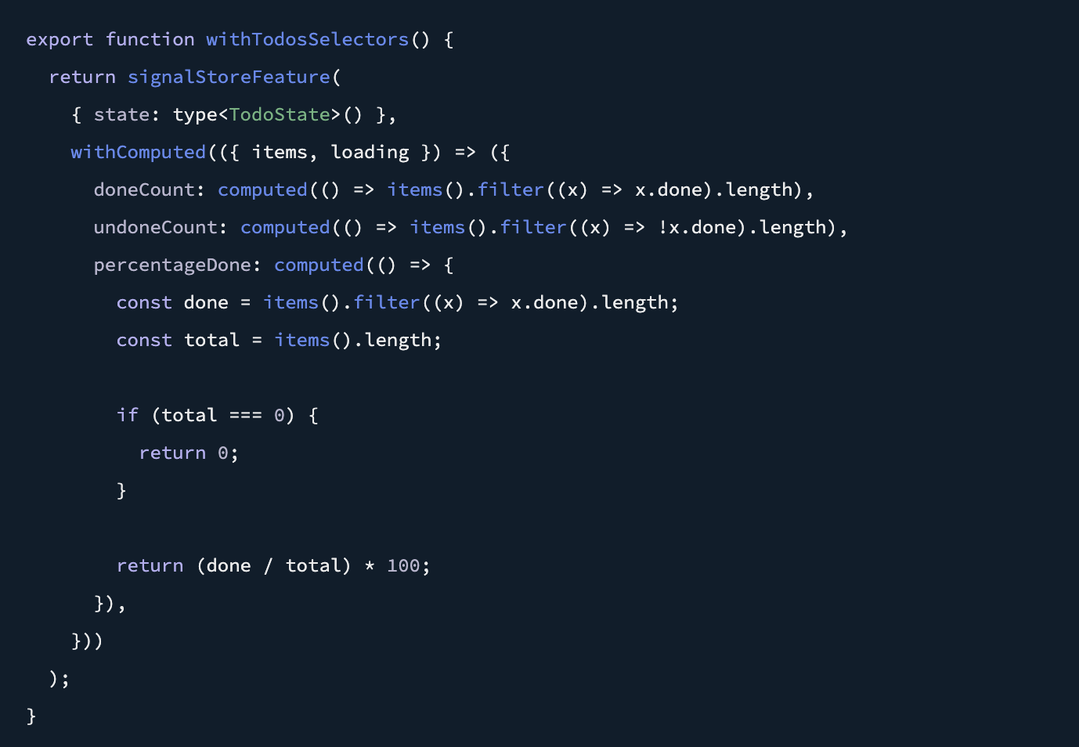
SignalStoreFeature

Slide 83
Summary

Slide 84
Comparison React frameworks
React API: For managing state within individual components, especially if simplicity and lightweightness are your priorities.
Context API: For sharing simple state between related components, especially if you're already familiar with React's Context API.
Zustand: For smaller applications or those with a focus on reactivity and flexibility.
Redux Toolkit: For large-scale applications with complex state that require strict data flow and centralized management.

Slide 85
Comparison NgRx and NgRx-SignalStore
RxJs is a good choice for small to medium size applications for state management.
NgRx is a good choice for large-scale applications with complex state.
NgRx-SignalStore is a good choice for smaller applications with a lot of real-time data changes.

Slide 86
Thank you

